Slide 1
Rule Based Approaches

Slide 2
Agenda
Announcements
Paper 1: Interpretable Rule Lists (Letham et. al.)
Break
Paper 2: Interpretable Rule Sets (Lakkaraju et. al.)

Slide 3
Announcements – Presentation Sign Up
Monday 10am ET (on the dot), we will release sign-up sheet for paper presentations
Form groups of 2 or 3 (no more) and write your names against the paper you would like to present
Only one paper per group (no more ☺)
Note: Each lecture covers two papers
First-come, first-serve assignments
Write names of all your group members on sign-up sheet

Slide 4
Announcements – Presentation Sign Up
Presentations start from October 4th and continue until November 22nd (except October 18th)
Hima and guest speaker will teach on October 18th
Think beforehand!
Each group will present for 50 minutes and answer questions for at least 10 more minutes
how you divide the presentation among yourselves is up to you
Two components to the grade: Group level (common to all group members), Individual

Slide 5
Announcements – Checkpoint 1
Now due on September 26th, 2019 at 11.59PM
2 or 3 members in one group
Use the templates we provided (Word, LaTeX)
3 pages
Name, email, project title
Motivation and Problem, Related Work, Proposed Method and Evaluation
List of problem statements is also out!
More discussion in office hours!

Slide 6
Questions??

Slide 7
Interpretable Classifiers Using Rules and Bayesian Analysis
Benjamin Letham, Cynthia Rudin, Tyler McCormick, David Madigan; 2015

Slide 8
Contributions
Introducing a generative model called Bayesian Rule Lists (BRL)
Goal is to output a decision list (if then elseif)
Novel prior structure to encourage sparsity
Predictive accuracy on par with top algorithms
Predicting risk of stroke – as interpretable as CHADS but more accurate

Slide 9
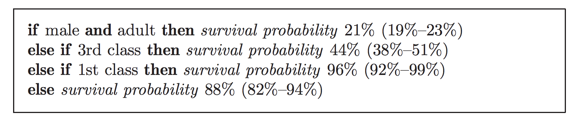
Decision List: Example
This is “an” accurate and interpretable decision list – possibly one of many such lists

Slide 10
Introduction: BRL
Produces a posterior distribution over permutations of if.. then.. elseif.. rules from a large set of premined rules
Decision lists with high posterior probability tend to be both accurate and interpretable
Prior favors concise lists with small number of rules and fewer terms in left hand side

Slide 11
Introduction: BRL
New type of balance between accuracy, interpretability, and computation
What about using other similar models?
Decision trees (CART)
They employ greedy construction methods
Not particularly computationally demanding but affects quality of solution – both accuracy and interpretability

Slide 12
Introduction: BRL
A major source of practical feasibility: pre-mined rules
Reduces model space
Complexity of problem depends on number of pre-mined rules
As long as pre-mined set is expressive, accurate decision list can be found + smaller model space means better generalization (Vapnik, 1995)
Additional advantage: Each rule is both interpretable and informative

Slide 13
Introduction: BRL
Prior encourages lists that are sparse
Sparse → reduced computation
BRL – accuracy as sophisticated ML models but interpretability as scoring systems

Slide 14
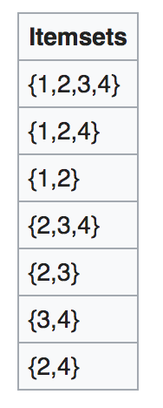
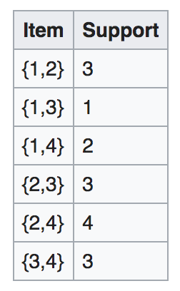
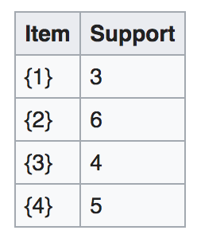
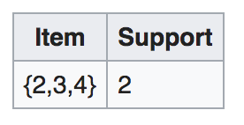
Pre-mined Rules: Intuition
Minimum Support = 3
This is Apriori algorithm. FP-growth is a single pass algorithm (more efficient)

Slide 15
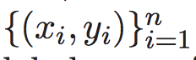
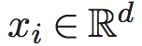
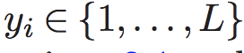
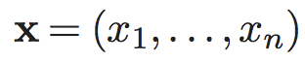
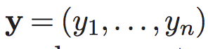
Preliminaries: Notation
Training data:
Two labels: stroke or no stroke

Slide 16
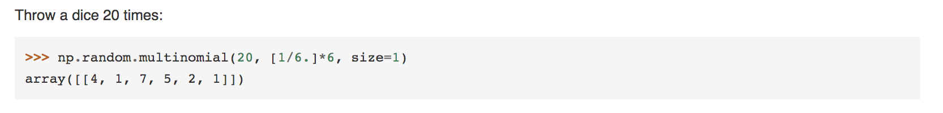
Preliminaries: Multinomial
Sampling from a multinomial:
Parameters are probability values

Slide 17
Preliminaries: Dirichlet
Think of a normal distribution:
We have mean and variance
The smaller the variance, the closer we are to mean
Dirichlet: sampling over a probability simplex
E.g., (0.6, 0.4);
K-dimensional Dirichlet has k parameters – any positive number
E.g., (60, 40)
Mean probability = (0.6, 0.4); Normalization factor = 100
The larger the normalization, the closer you are to mean

Slide 18
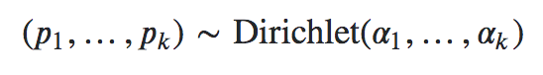
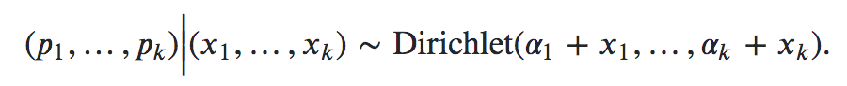
Preliminaries: Dirichlet Prior
Conjugate prior for multinomial distribution
Conjugate prior: posterior in the same family as prior
Prior:
Posterior:

Slide 19
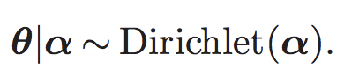
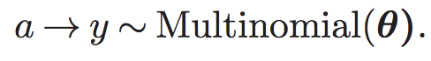
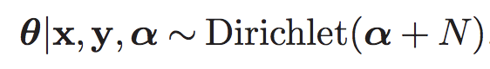
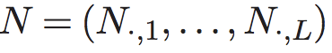
Bayesian Association Rules

Slide 20
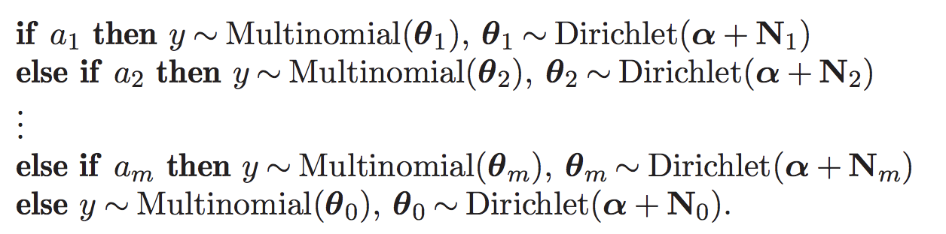
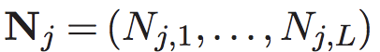
Bayesian Decision Lists
where

Slide 21
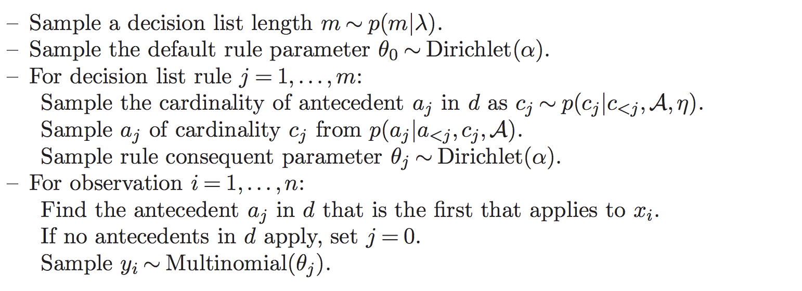
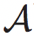
Generative Model
Our goal is to sample from the posterior distribution over antecedent lists:
is complete collection of pre-mined antecedents

Slide 22
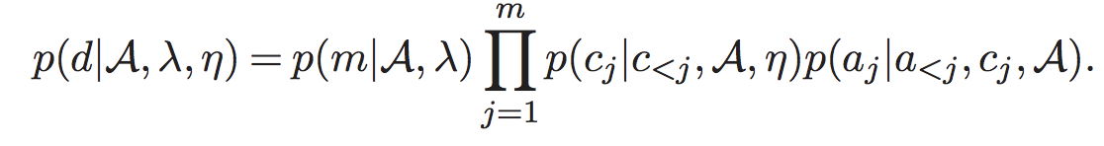
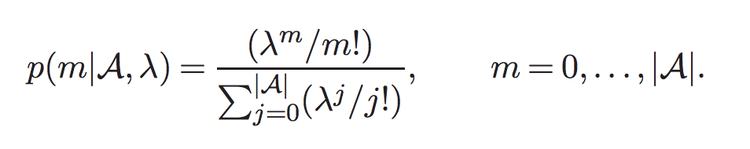
Prior Probabilities
Truncated Poisson:
Ensures that sampled values are within bounds!
Also, ensures expected value is close to
when there are a large number of pre-mined rules

Slide 23
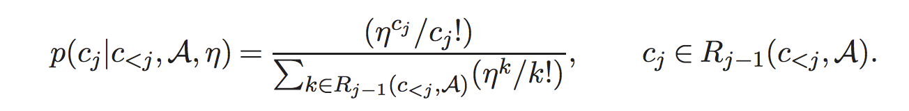
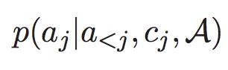
Prior Probabilities
Another Truncated Poisson,
Excludes any cardinalities that have been exhausted!
is sampled uniformly from available antecedents with appropriate cardinality.

Slide 24
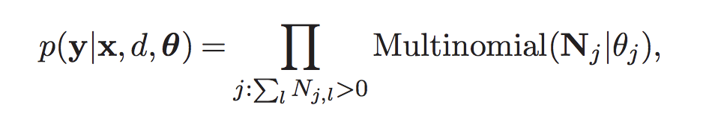
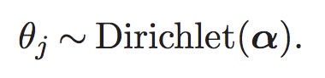
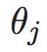
Likelihood
Likelihood is the product of multinomial probability mass functions for the observed label counts at each rule
Marginalize over → integrate out the intermediate parameter

Slide 25
Markov Chain Monte Carlo
Generate a chain of random samples until convergence
Each random sample is a stepping stone for the next one (chain)
New samples do not depend on any samples before the previous one (Markov)

Slide 26
Markov Chain Monte Carlo
How to go to (optimal) d* from current d^{t}
Move an antecedent to a different position in the list
Move step by step and converge to d*
Add an antecedent that is not currently in the list
Remove an antecedent from the list

Slide 27
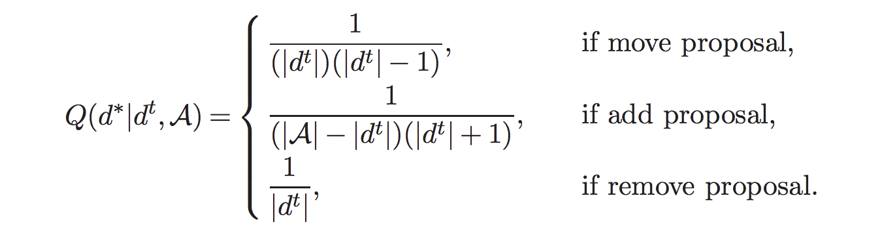
Proposal Probabilities
Move chosen uniformly
Which antecedents and their new position is also chosen uniformly

Slide 28
Metropolis Hastings
After you choose your move and its nitty-gritties, you compute an acceptance probability “a”
See white board
Generate a random number “u”
If u <= a, then accept otherwise reject

Slide 29
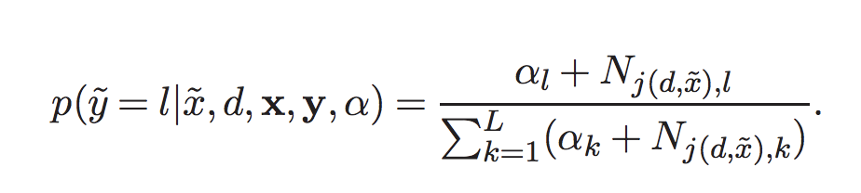
Estimating label of a new observation
Match the antecedent by looking at feature values of new observation

Slide 30
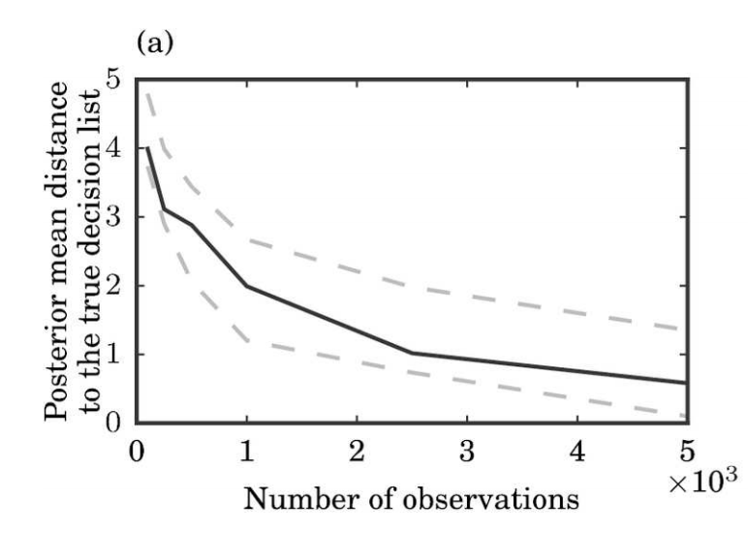
Simulation
Levenshtein edit distance – median value across 100 simulated datasets

Slide 31
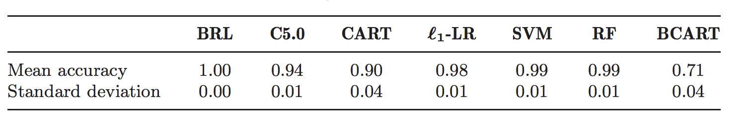
Tic-Tac-Toe
5 fold cross validation; accuracy computed across 5 folds

Slide 32
Stroke Prediction
N = 12,586, 14% had stroke
6000 times larger than data for CHADS2 score
Pre-mining: support 10% and max cardinality 2
5 fold evaluation

Slide 33
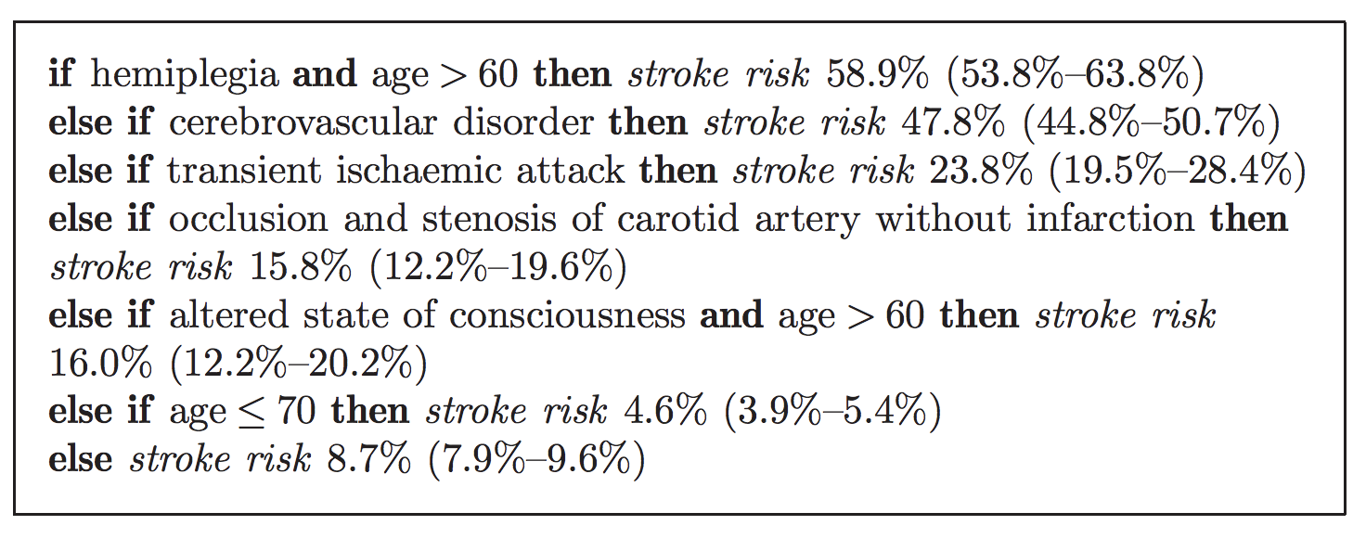
Stroke Prediction

Slide 34
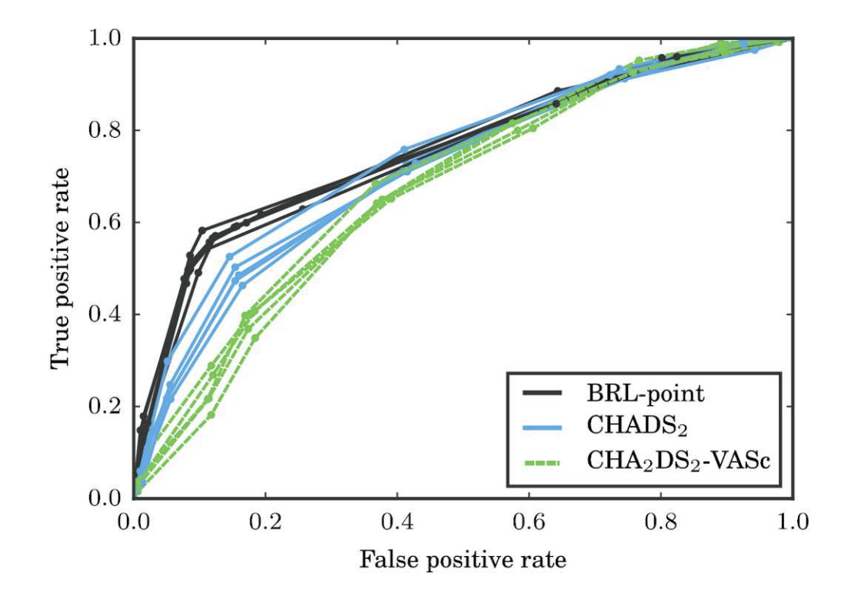
Stroke Prediction – ROC Curve

Slide 35
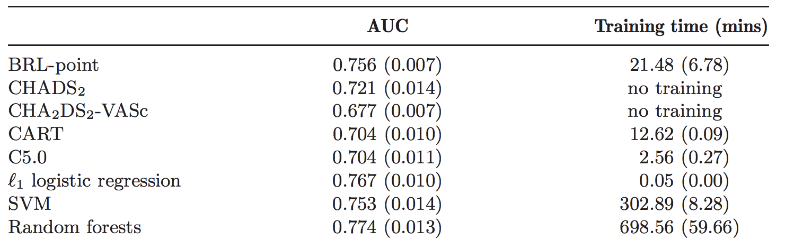
Stroke Prediction - AUC

Slide 36
Questions??

Slide 37
Let’s start the critique!

Slide 38
Interpretable Decision Sets
Hima Lakkaraju, Stephen Bach, Jure Leskovec; 2016

Slide 39
Contributions
A framework called Interpretable Decision Sets (IDS) for classification
Novel objective function + proof of submodularity
Optimization procedure with optimality guarantees
Detailed metrics for evaluating interpretability + user studies

Slide 40
Motivation
Traditional classification models optimize for predictive accuracy
Very little understanding of the model itself and its predictions
Model being “readable” is not enough
Humans should be able to reason about predictions and readily explain the functionality of the model

Slide 41
Considerations
How do we define interpretability?
What kind of algorithmic solutions can effectively trade off interpretability and accuracy?
How can we ensure that humans are able to understand what the model is doing?

Slide 42
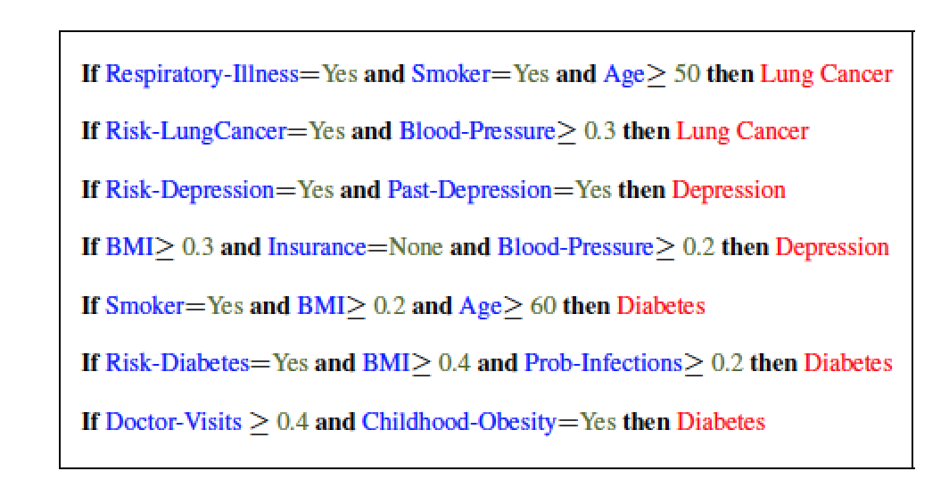
Decision Sets

Slide 43
Criteria for Interpretability
Parsimony: Fewer rules with fewer conditions
Cognitive limits of human understanding
Distinctness: Minimal overlap of rules w.r.t the data points they cover
No redundant and contradicting explanations of data points
Class Coverage: Explain all the classes in the data
Rules explaining minority classes are important

Slide 44
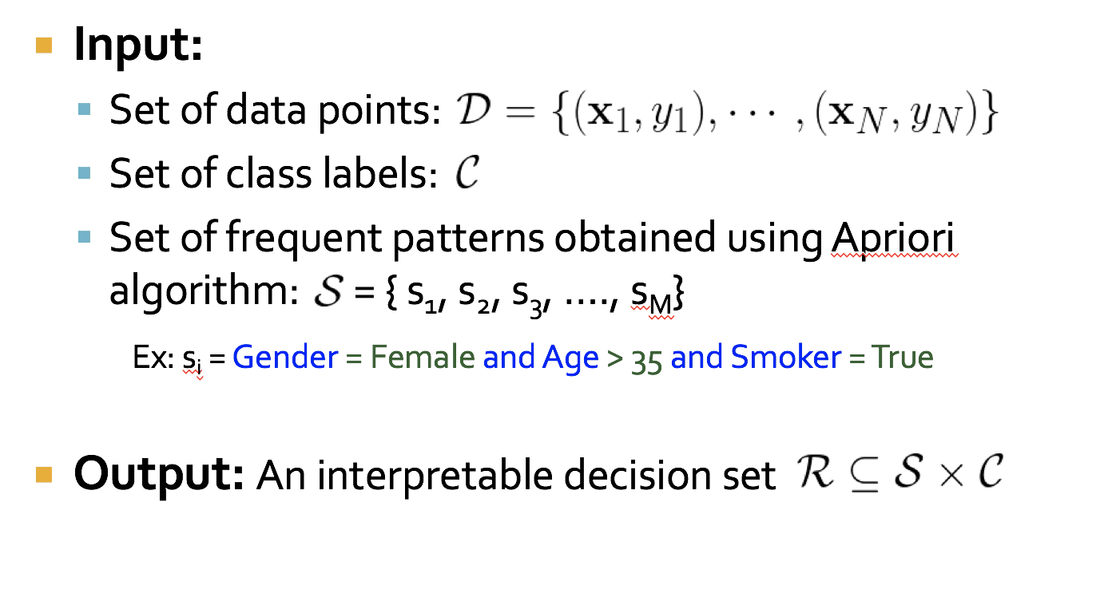
Problem Formulation

Slide 45
Desiderata
We need to optimize for the following criteria
Recall
Precision
Distinctness
Parsimony
Class Coverage
Recall and Precision → Accurate predications
Distinctness, Parsimony, and Class Coverage →Interpretability

Slide 46
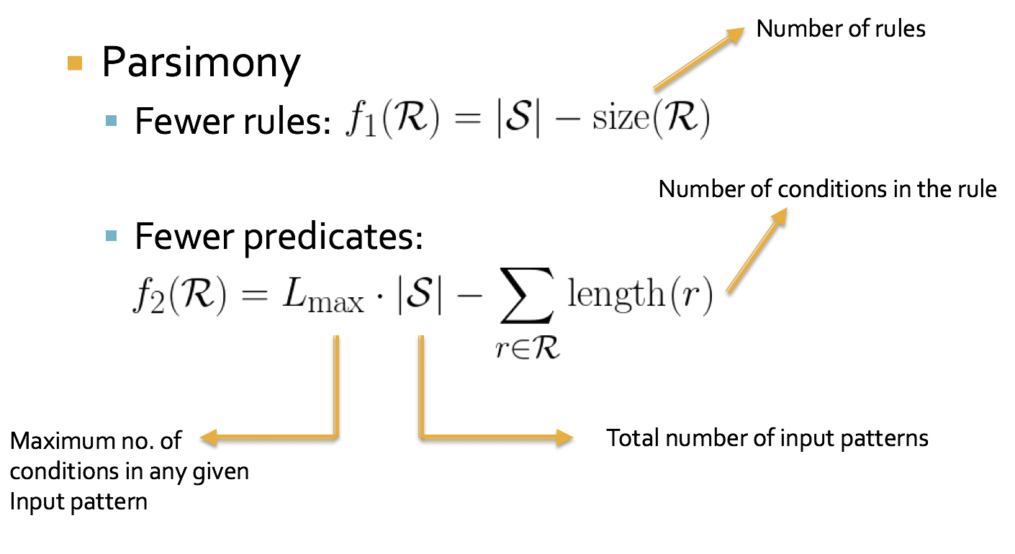
Objective Function

Slide 47
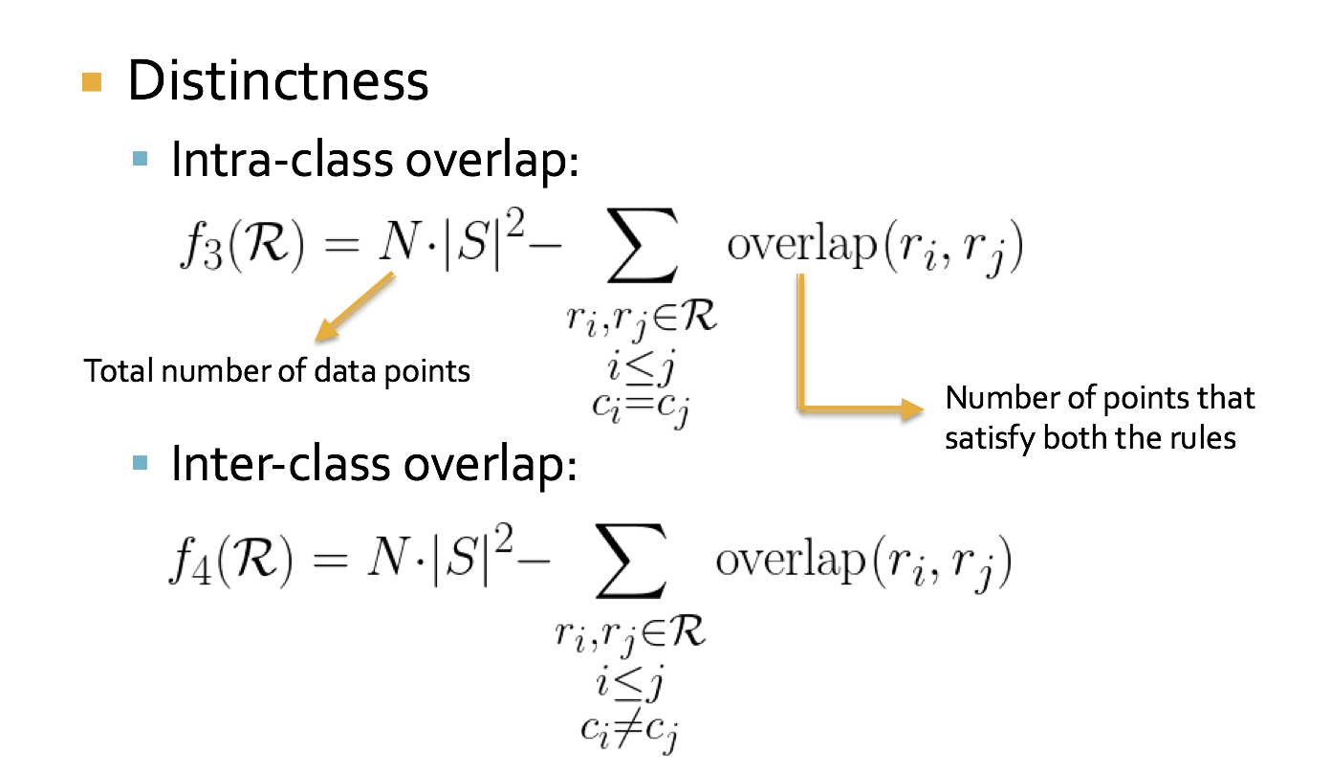
Objective Function

Slide 48
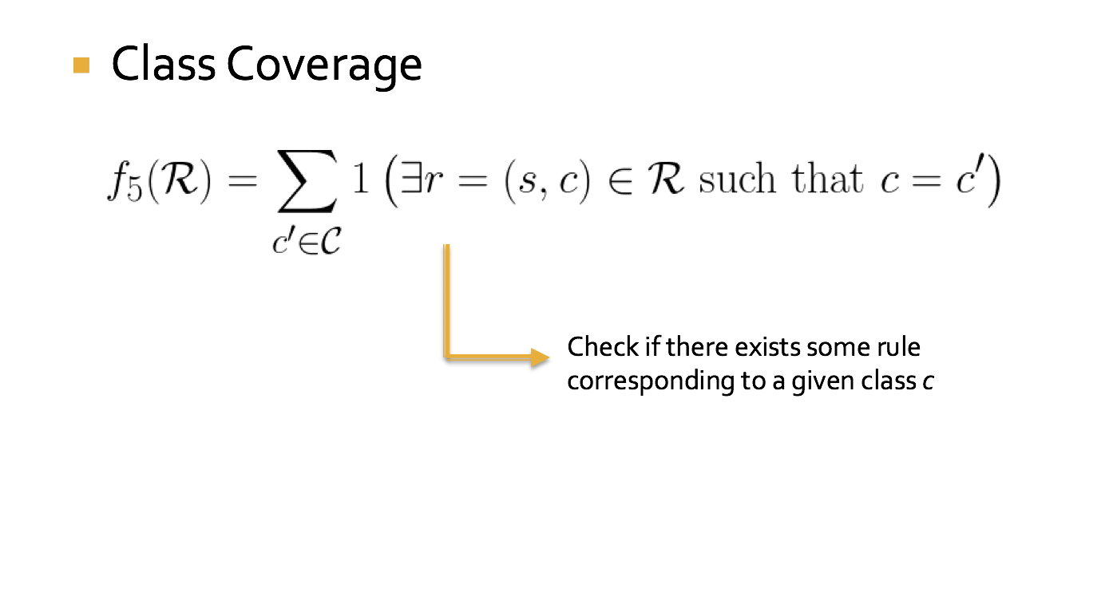
Objective Function

Slide 49
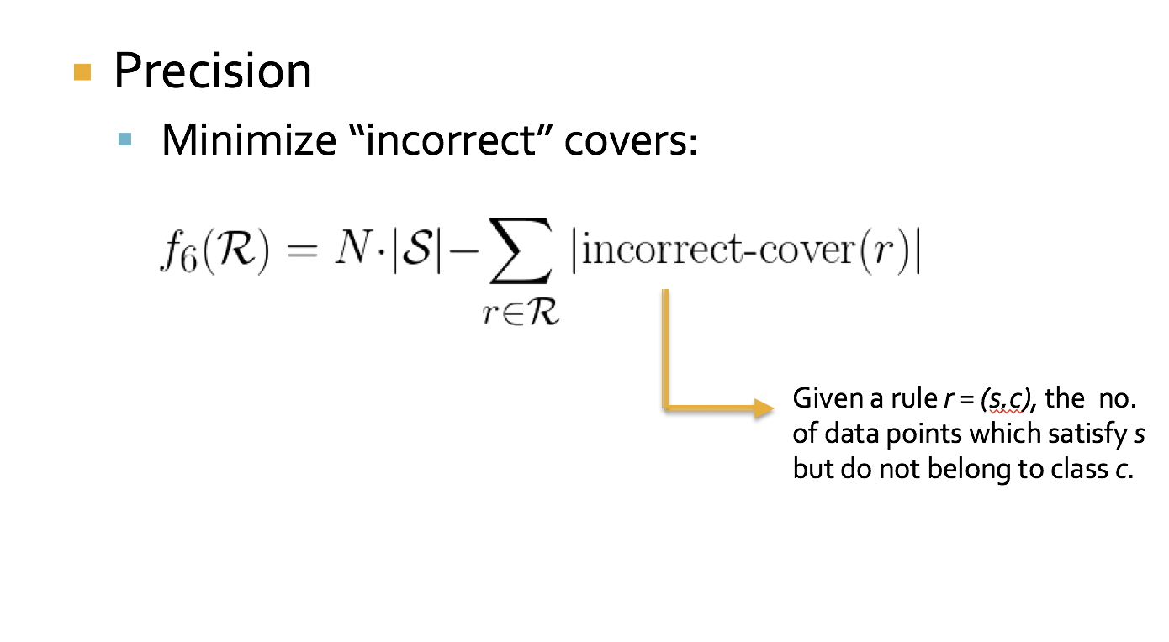
Objective Function

Slide 50
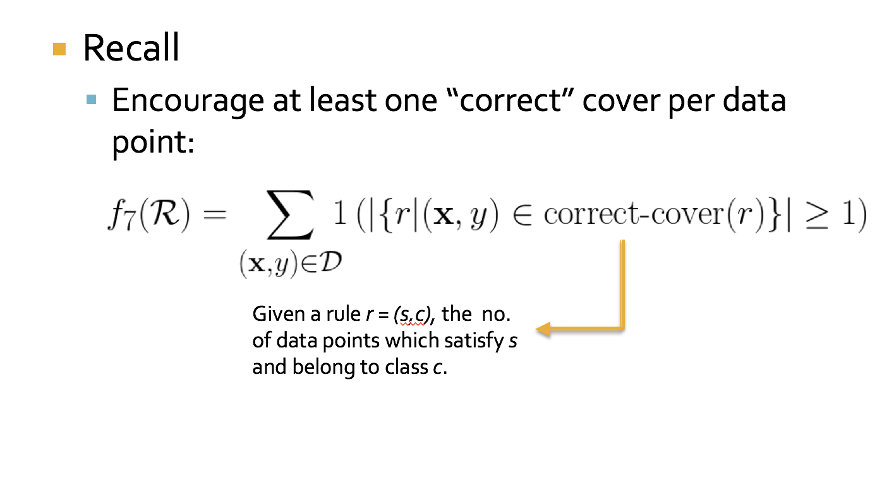
Objective Function

Slide 51
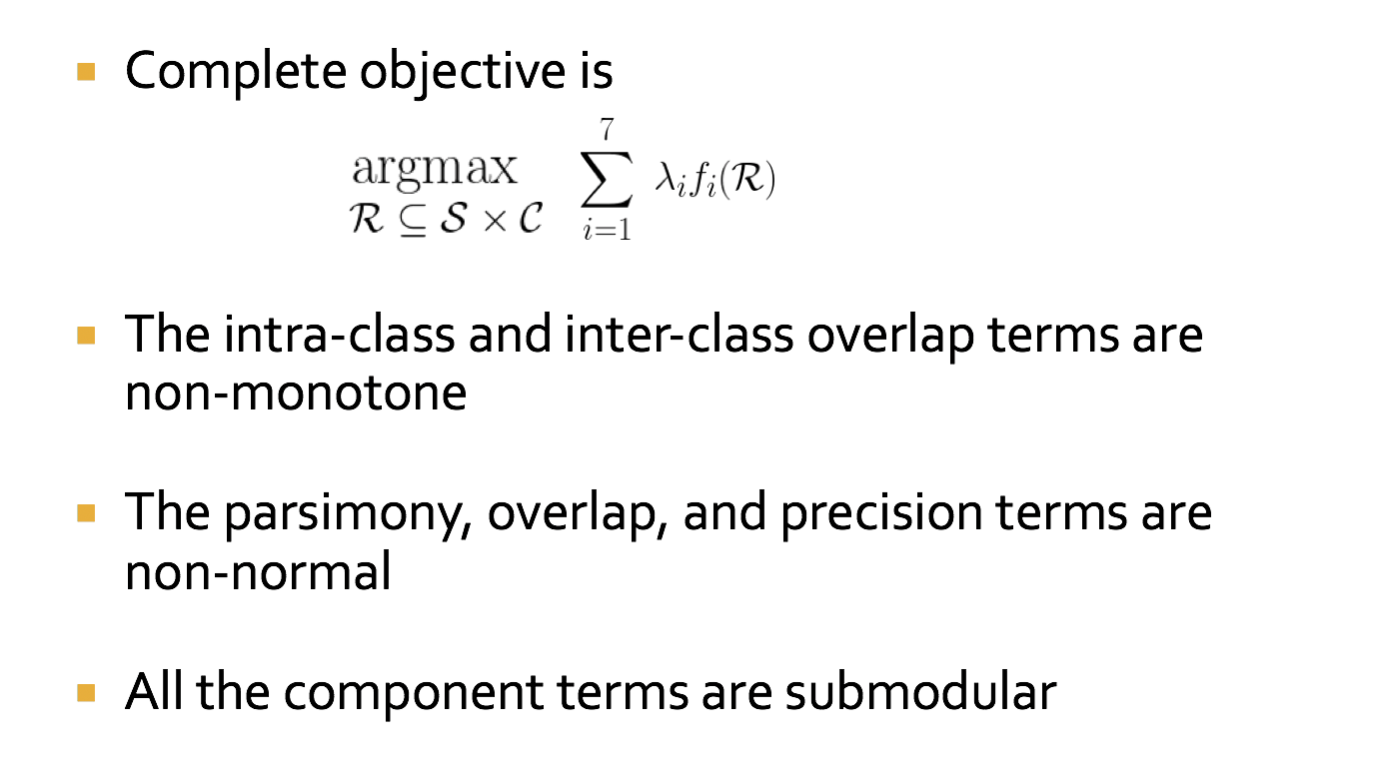
Objective Function

Slide 52
Submodularity
Diminishing returns characterization
F(A ∪ d) – F(A) ≥ F(B ∪ d) – F(B)
Gain of adding d to a small set
Gain of adding d to a large set
B
+
d
Large improvement
A
+
d
Small improvement
A non-negative linear combination of
submodular functions is submodular
Notes:
A \subset B

Slide 53
Objective Function
The complete objective is non-negative, non-normal, non-monotone, submodular

Slide 54
Optimizing the Objective
Maximizing a non-monotone submodular function is NP-hard
Smooth local search [SLS] algorithm provides a 2/5 approximation [Feige, Mirrokni, Vondrak FOCS 07; SIAM Comp. J. 11 ]
Will be at least 2/5 of the optimal solution

Slide 55
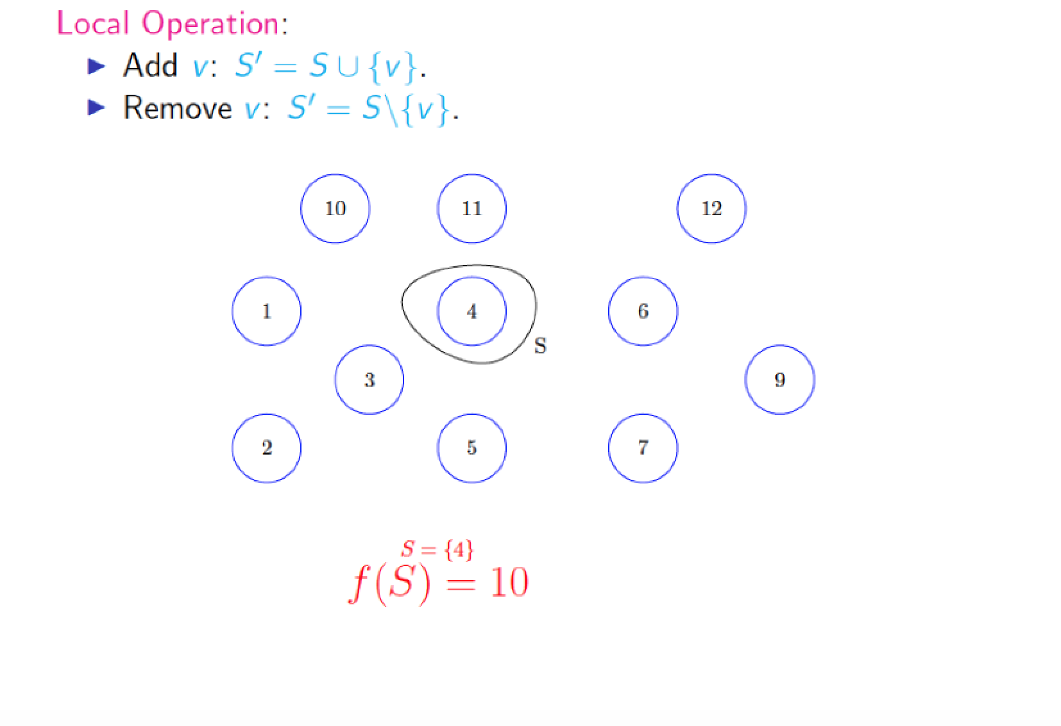
Submodular Maximization: Local Search
Each node here
corresponds to a
candidate
rule = (pattern, class) tuple
S and S’ correspond to the intermediate solution sets

Slide 56
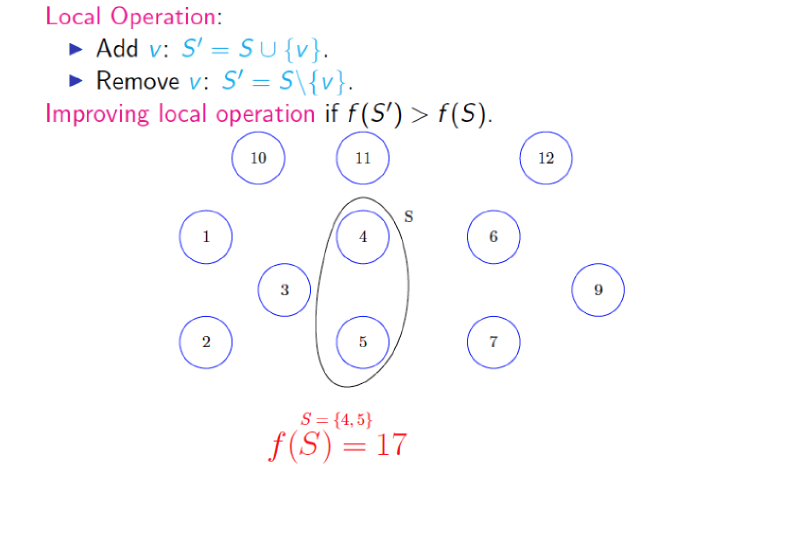
Submodular Maximization: Local Search
S and S’ correspond to the intermediate solution sets

Slide 57
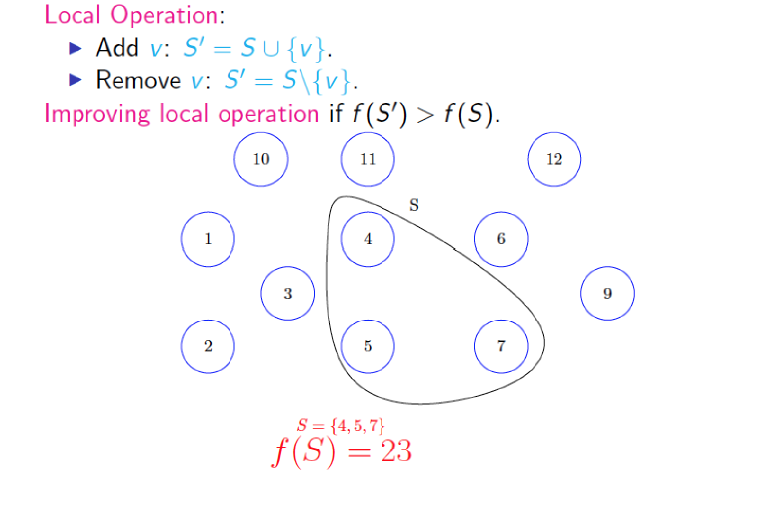
Submodular Maximization: Local Search
S and S’ correspond to the intermediate solution sets

Slide 58
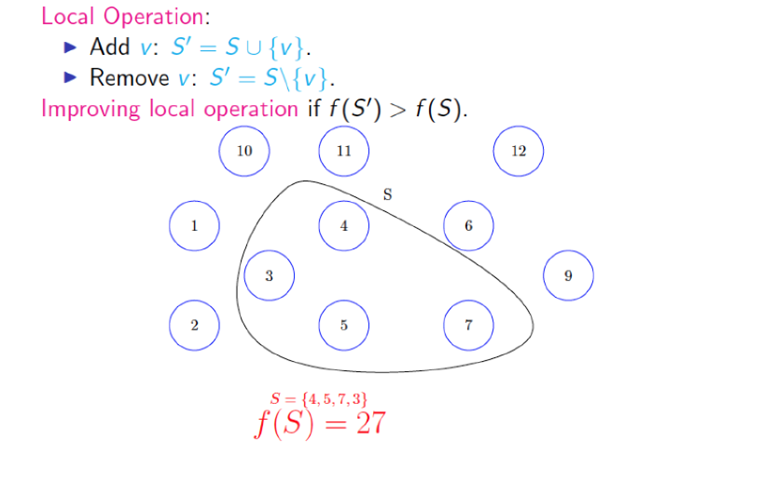
Submodular Maximization: Local Search
S and S’ correspond to the intermediate solution sets

Slide 59
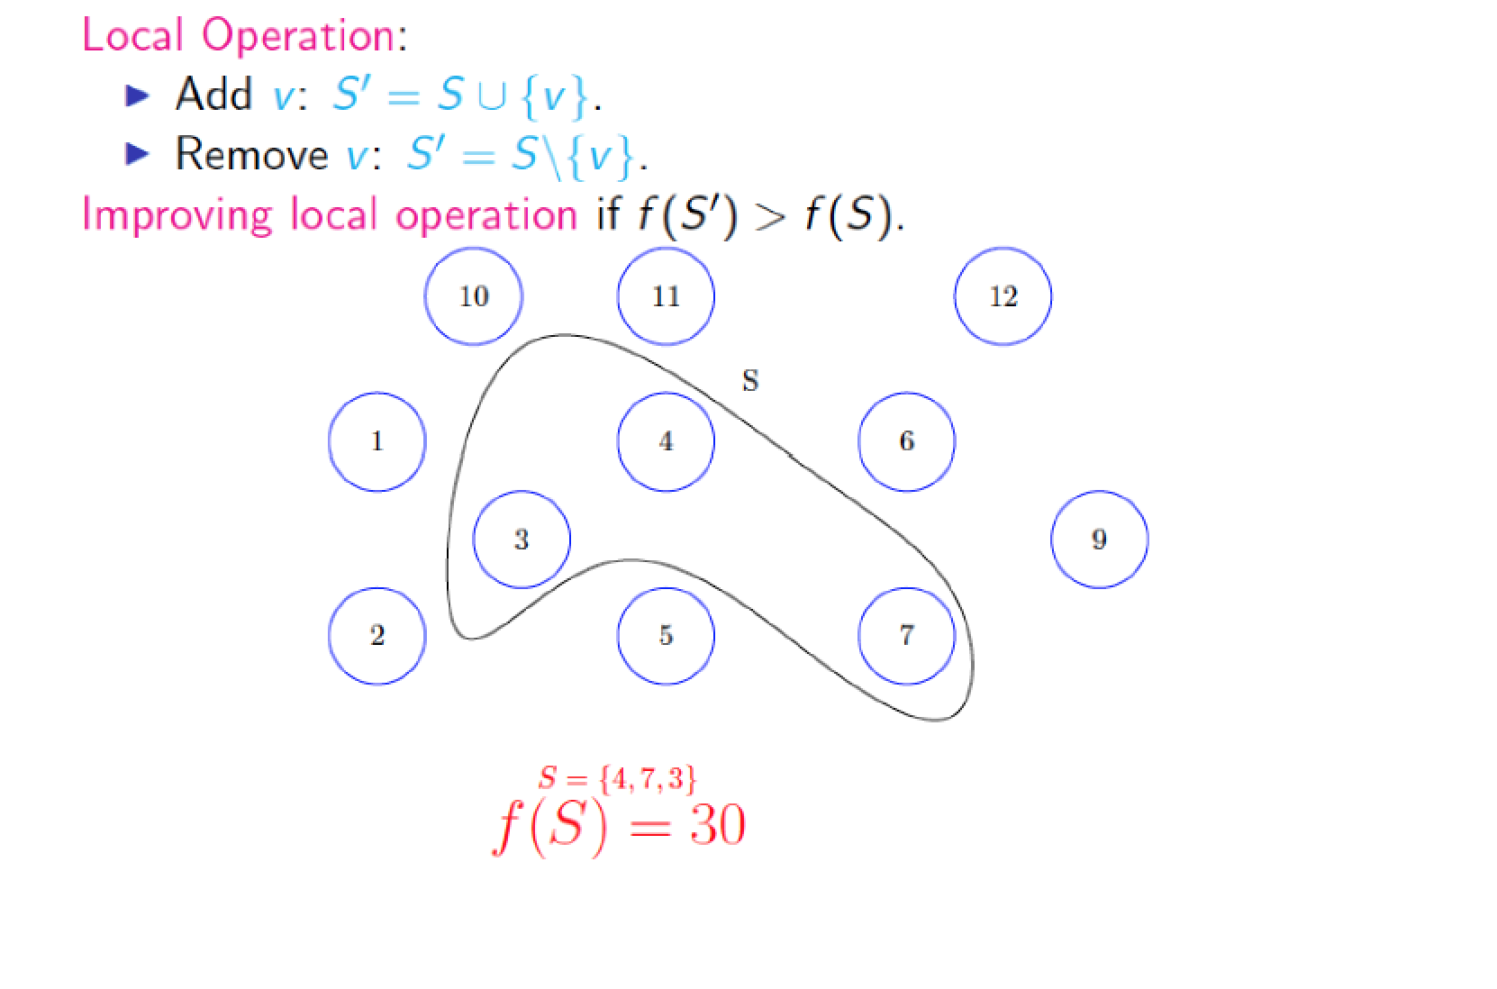
Submodular Maximization: Local Search
S and S’ correspond to the intermediate solution sets

Slide 60
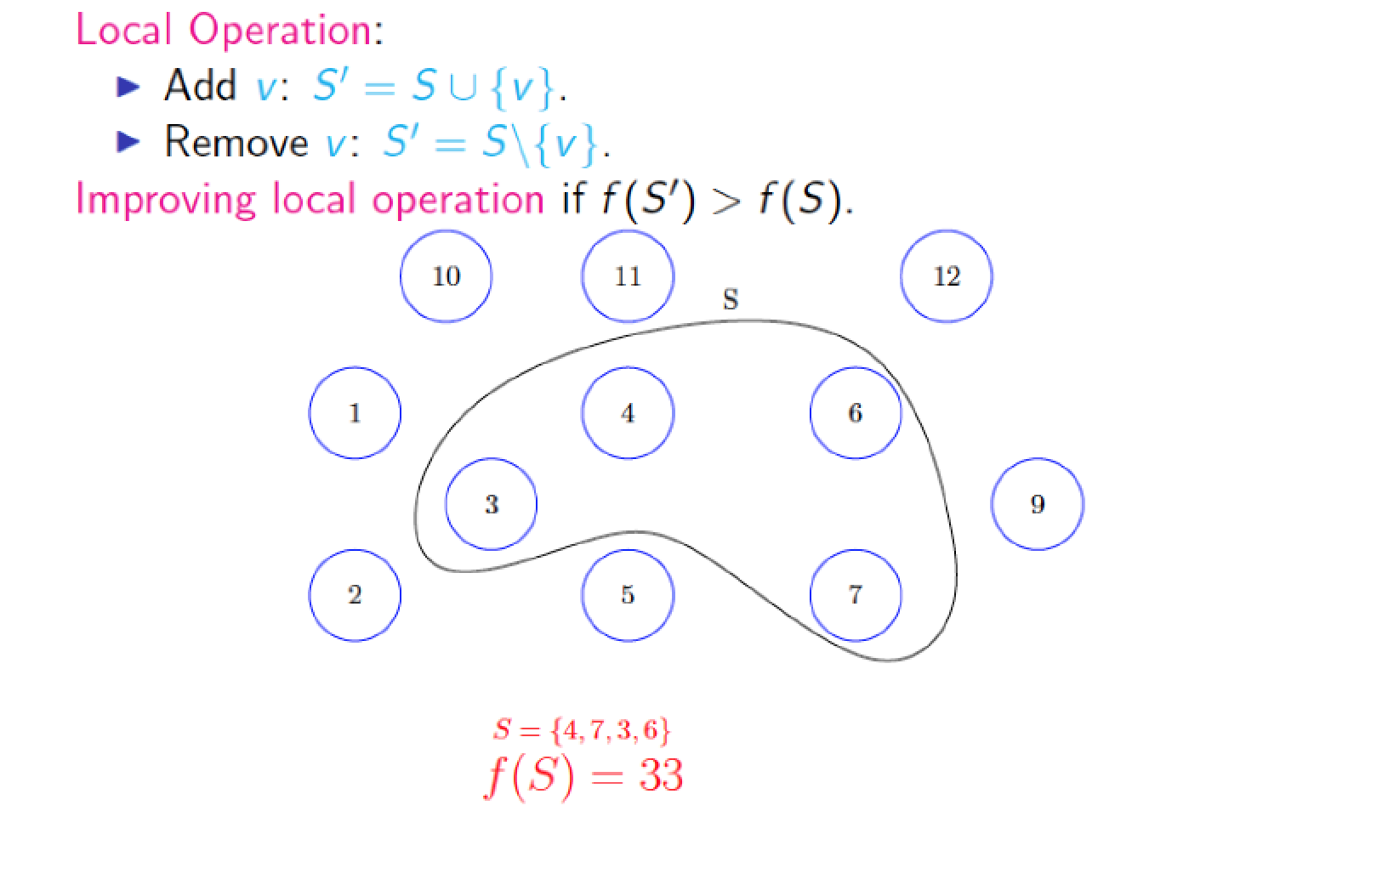
Submodular Maximization: Local Search
S and S’ correspond to the intermediate solution sets

Slide 61
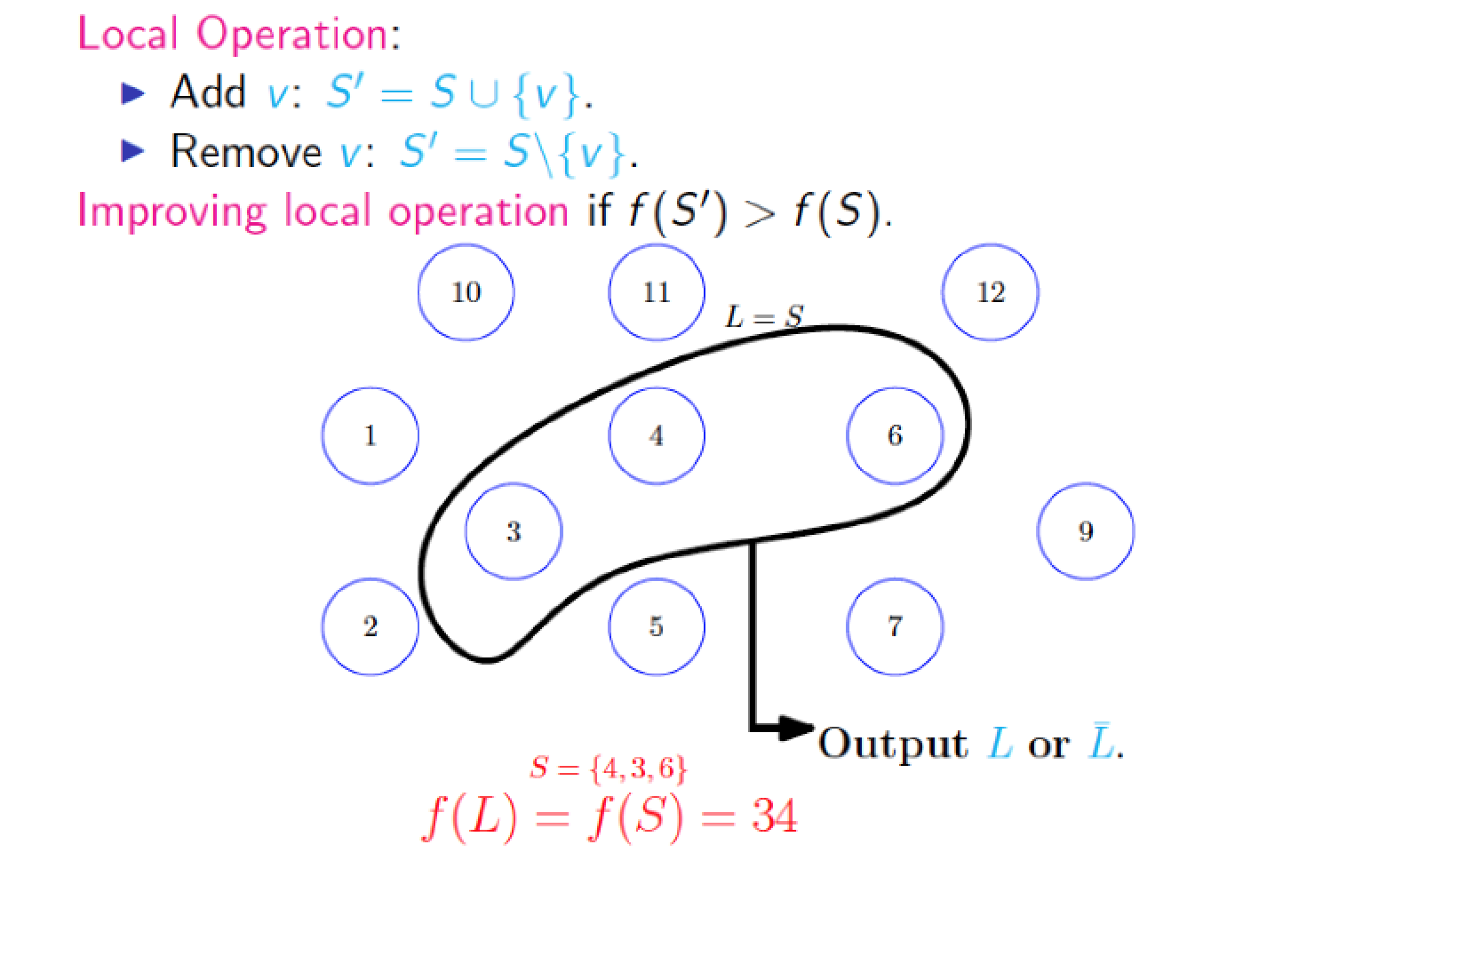
Submodular Maximization: Local Search
S and S’ correspond to the intermediate solution sets

Slide 62
Local Search
~1/3 approximation
At least 1/3 of optimal solution
So, we use a slightly different version of this algorithm
Smooth local search
2/5 approximation

Slide 63

Smooth Local Search
Initialization
Marginal gain
If marginal gain > threshold,
Add element
If marginal gain < threshold,
Add element

Slide 64
Evaluation: Datasets
Dataset | # of datapoints | Features | Classes
Bail Outcomes | 86K | Gender, age, current offense details, past criminal record | No Risk, Failure to Appear, New Criminal Activity
Student Performance | 21K | Gender, age, grades, `absence rates & tardiness behavior through grades 6 to 8, suspension/withdrawal history | Graduated on Time, Delayed Graduation, Dropped out
Medical Diagnosis | 150K | Current ailments, age, BMI, gender, smoking habits, medical history, family history | Asthma, Diabetes, Depression, Lung Cancer, Rare Blood Cancer

Slide 65

Parameter Setting
Trade-off parameters
Initialize everything to 0
Validation set: 5% of dataset (does not overlap with train/test set)
Coordinate ascent:
Keep all except one parameter constant
Small increment to that one parameter
See how AUC changes – if increases and does not violate constraints, then keep incrementing
Fraction Overlap <= 0.10, Fraction Uncovered <= 0.15, Avg. Rule Length <= 10, Number of rules <= 15, Fraction Classes = 1.0

Slide 66
Evaluating Predictive Performance
Method | AUC Bail Data | AUC Student Data | AUC Medical Data
Our Approach | 69.78 | 75.12 | 61.19
Bayesian Decision Lists (Letham et. al.) | 67.18 | 72.54 | 59.18
Classification Based on Association (Liu et. al.) | 70.68 | 76.02 | 63.03
CN2 | 71.02 | 76.36 | 64.78
Decision Trees | 70.08 | 75.31 | 63.28
Gradient Boosted Trees | 71.23 | 77.18 | 64.21
Random Forests | 70.87 | 77.12 | 63.92

Slide 67
Evaluating Goodness of Rules
Results on Medical Diagnosis Data
Method | Fraction of Overlap | Fraction of Data Points Uncovered | Avg. Rule Width | Num. Rules | Fraction of Classes Covered
Our Approach | 0.09 | 0.13 | 3.17 | 12 | 1.0
Bayesian Decision Lists (Letham et. al.) | 0.00 | 0.18 | 8.46 | 11 | 0.67
Classification Based on Association (Liu et. al.) | 0.00 | 0.14 | 8.60 | 32 | 1.00
CN2 | 0.12 | 0.14 | 9.78 | 38 | 1.00

Slide 68

Ablation Study
Results on Medical Diagnosis Data

Slide 69
Evaluating Interpretability: User Study
Compared our interpretable decision sets to Bayesian Decision Lists (Letham et. al.)
Each user is randomly assigned one of the two models
10 objective and 2 descriptive questions per user

Slide 70

Interface for Objective Questions

Slide 71

Interface for Descriptive Questions

Slide 72
User Study Results
Task | Metrics | Our Approach | Bayesian Decision Lists
Descriptive | Human Accuracy | 0.81 | 0.17
 | Avg. Time Spent (secs.) | 113.4 | 396.86
 | Avg. # of Words | 31.11 | 120.57
Objective | Human Accuracy | 0.97 | 0.82
 | Avg. Time Spent (secs.) | 28.18 | 36.34
Objective Questions: 17% more accurate, 22% faster;
Descriptive Questions: 74% fewer words, 71% faster.

Slide 73
Questions??

Slide 74
Let’s start the critique!

